Slide 1
Scheduling
Goal
  To understand the role that scheduling and schedulability analysis plays in predicting that real-time applications meet their deadlines
Topics
  Simple process model
  The cyclic executive approach
  Process-based scheduling
  Utilization-based schedulability tests
  Response time analysis for FPS and EDF
  Worst-case execution time
  Sporadic and aperiodic processes
  Process systems with D < T
  Process interactions, blocking and priority ceiling protocols
  An extendible process model
  Dynamic systems and on-line analysis
  Programming priority-based systems

Slide 2
Scheduling
In general, a scheduling scheme provides two features:
  An algorithm for ordering the use of system resources (in particular the CPUs)
  A means of predicting the worst-case behaviour of the system when the scheduling algorithm is applied
The prediction can then be used to confirm the temporal requirements of the application

Slide 3
Simple Process Model
The application is assumed to consist of a fixed set of processes
All processes are periodic, with known periods
The processes are completely independent of each other
All system's overheads, context-switching times and so on are ignored (i.e, assumed to have zero cost)
All processes have a deadline equal to their period (that is, each process must complete before it is next released)
All processes have a fixed worst-case execution time

Slide 4
Standard Notation
B
C
D
I
J
N
P
R
T
U
a-z
Worst-case blocking time for the process (if applicable)
Worst-case computation time (WCET) of the process
Deadline of the process
The interference time of the process
Release jitter of the process
Number of processes in the system
Priority assigned to the process (if applicable)
Worst-case response time of the process
Minimum time between process releases (process period)
The utilization of each process (equal to C/T)
The name of a process

Slide 5
Cyclic Executives
One common way of implementing hard real-time systems is to use a cyclic executive
Here the design is concurrent but the code is produced as a collection of procedures
Procedures are mapped onto a set of minor cycles that constitute the complete schedule (or major cycle)
Minor cycle dictates the minimum cycle time
Major cycle dictates the maximum cycle time
Has the advantage of being fully deterministic

Slide 6
Consider Process Set
Process Period,T Computation Time,C
a 25 10
b 25 8
c 50 5
d 50 4
e 100 2

Slide 7
Cyclic Executive
loop
wait_for_interrupt;
procedure_for_a; procedure_for_b; procedure_for_c;
wait_for_interrupt;
procedure_for_a; procedure_for_b; procedure_for_d;
procedure_for_e;
wait_for_interrupt;
procedure_for_a; procedure_for_b; procedure_for_c;
wait_for_interrupt;
procedure_for_a; procedure_for_b; procedure_for_d;
end loop;

Slide 8
Time-line for Process Set
Interrupt
Interrupt
Interrupt
Interrupt
a
b
c
a
b
d
e
a
b
c

Slide 9
Properties
No actual processes exist at run-time; each minor cycle is just a sequence of procedure calls
The procedures share a common address space and can thus pass data between themselves. This data does not need to be protected (via a semaphore, for example) because concurrent access is not possible
All “process” periods must be a multiple of the minor cycle time

Slide 10
Problems with Cycle Executives
The difficulty of incorporating processes with long periods; the major cycle time is the maximum period that can be accommodated without secondary schedules
Sporadic activities are difficult (impossible!) to incorporate
The cyclic executive is difficult to construct and difficult to maintain — it is a NP-hard problem
Any “process” with a sizable computation time will need to be split into a fixed number of fixed sized procedures (this may cut across the structure of the code from a software engineering perspective, and hence may be error-prone)
More flexible scheduling methods are difficult to support
Determinism is not required, but predictability is

Slide 11
Process-Based Scheduling
Scheduling approaches
  Fixed-Priority Scheduling (FPS)
  Earliest Deadline First (EDF)
  Value-Based Scheduling (VBS)

Slide 12
Fixed-Priority Scheduling (FPS)
This is the most widely used approach and is the main focus of this course
Each process has a fixed, static, priority which is computer pre-run-time
The runnable processes are executed in the order determined by their priority
In real-time systems, the “priority” of a process is derived from its temporal requirements, not its importance to the correct functioning of the system or its integrity

Slide 13
Earliest Deadline First (EDF) Scheduling
The runnable processes are executed in the order determined by the absolute deadlines of the processes
The next process to run being the one with the shortest (nearest) deadline
Although it is usual to know the relative deadlines of each process (e.g. 25ms after release), the absolute deadlines are computed at run time and hence the scheme is described as dynamic

Slide 14
Value-Based Scheduling (VBS)
If a system can become overloaded then the use of simple static priorities or deadlines is not sufficient; a more adaptive scheme is needed
This often takes the form of assigning a value to each process and employing an on-line value-based scheduling algorithm to decide which process to run next

Slide 15
Preemption and Non-preemption
With priority-based scheduling, a high-priority process may be released during the execution of a lower priority one
In a preemptive scheme, there will be an immediate switch to the higher-priority process
With non-preemption, the lower-priority process will be allowed to complete before the other executes
Preemptive schemes enable higher-priority processes to be more reactive, and hence they are preferred
Alternative strategies allow a lower priority process to continue to execute for a bounded time
These schemes are known as deferred preemption or cooperative dispatching
Schemes such as EDF and VBS can also take on a pre-emptive or non pre-emptive form

Slide 16

FPS and Rate Monotonic Priority Assignment
Each process is assigned a (unique) priority based on its period; the shorter the period, the higher the priority
I.e, for two processes i and j,
This assignment is optimal in the sense that if any process set can be scheduled (using pre-emptive priority-based scheduling) with a fixed-priority assignment scheme, then the given process set can also be scheduled with a rate monotonic assignment scheme
Note, priority 1 is the lowest (least) priority

Slide 17
Example Priority Assignment
Process Period, T Priority, P
a 25 5
b 60 3
c 42 4
d 105 1
e 75 2

Slide 18
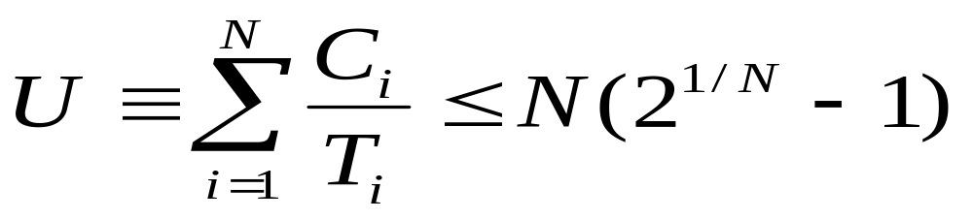

Utilisation-Based Analysis
For D=T task sets only
A simple sufficient but not necessary schedulability test exists

Slide 19
Utilization Bounds
N Utilization bound
1 100.0%
2 82.8%
3 78.0%
4 75.7%
5 74.3%
10 71.8%
Approaches 69.3% asymptotically

Slide 20
Process Set A
Process Period ComputationTime Priority Utilization
T C P U
a 50 12 1 0.24
b 40 10 2 0.25
c 30 10 3 0.33
The combined utilization is 0.82 (or 82%)
This is above the threshold for three processes (0.78) and, hence, this process set fails the utilization test

Slide 21
Time-line for Process Set A
Process
a
Process Release Time
Process Completion Time
Deadline Met
b
Process Completion Time
Deadline Missed
Preempted
c
Executing
0
10
20
30
40
50
60
Time

Slide 22
Gantt Chart for Process Set A
c
b
a
c
b
0
10
20
30
40
50
Time

Slide 23
Process Set B
Process Period ComputationTime Priority Utilization
T C P U
a 80 32 1 0.400
b 40 5 2 0.125
c 16 4 3 0.250
The combined utilization is 0.775
This is below the threshold for three processes (0.78) and, hence, this process set will meet all its deadlines

Slide 24
Process Set C
Process Period ComputationTime Priority Utilization
T C P U
a 80 40 1 0.50
b 40 10 2 0.25
c 20 5 3 0.25
The combined utilization is 1.0
This is above the threshold for three processes (0.78) but the process set will meet all its deadlines

Slide 25
Time-line for Process Set C
Process
a
b
c
0
10
20
30
40
50
60
70
80
Time

Slide 26
Criticism of Utilisation-based Tests
Not exact
Not general
BUT it is O(N)
The test is said to be sufficient but not necessary

Slide 27
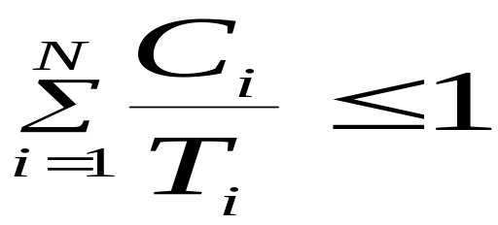
Utilization-based Test for EDF
A much simpler test
Superior to FPS; it can support high utilizations. However
FPS is easier to implement as priorities are static
EDF is dynamic and requires a more complex run-time system which will have higher overhead
It is easier to incorporate processes without deadlines into FPS; giving a process an arbitrary deadline is more artificial
It is easier to incorporate other factors into the notion of priority than it is into the notion of deadline
During overload situations
  FPS is more predictable; Low priority process miss their deadlines first
  EDF is unpredictable; a domino effect can occur in which a large number of processes miss deadlines

Slide 28
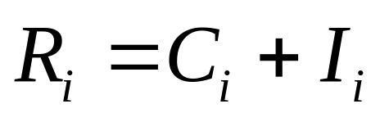
Response-Time Analysis
Here task i's worst-case response time, R, is calculated first and then checked (trivially) with its deadline
R ≤ D
i
i
Where I is the interference from higher priority tasks

Slide 29
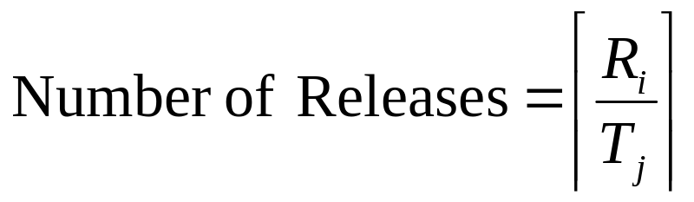

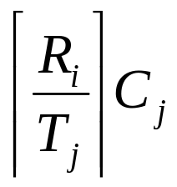
Calculating R
During R, each higher priority task j will execute a number of times:
The ceiling function gives the smallest integer greater than the fractional number on which it acts. So the ceiling of 1/3 is 1, of 6/5 is 2, and of 6/3 is 2.
Total interference is given by:

Slide 30
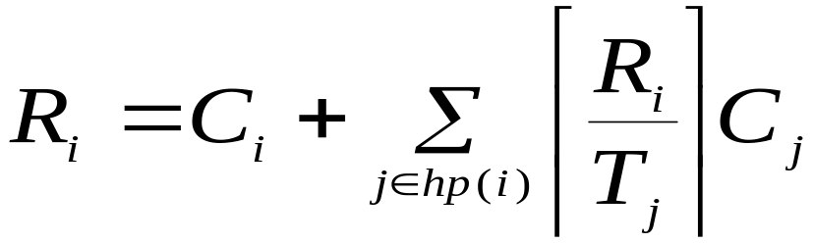
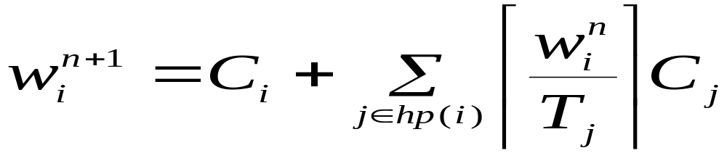





Response Time Equation
Where hp(i) is the set of tasks with priority higher than task i
Solve by forming a recurrence relationship:
The set of values is monotonically non decreasing
When the solution to the equation has been found,
must not be greater that (e.g. 0 or )

Slide 31





Response Time Algorithm
for i in 1..N loop -- for each process in turn
n := 0
loop
calculate new
if then
exit value found
end if
if then
exit value not found
end if
n := n + 1
end loop
end loop

Slide 32
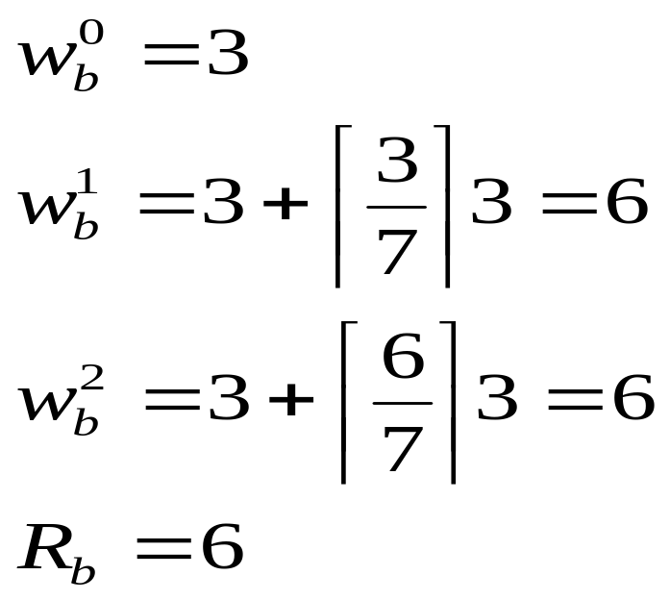

Process Set D
Process Period ComputationTime Priority
T C P
a 7 3 3
b 12 3 2
c 20 5 1

Slide 33
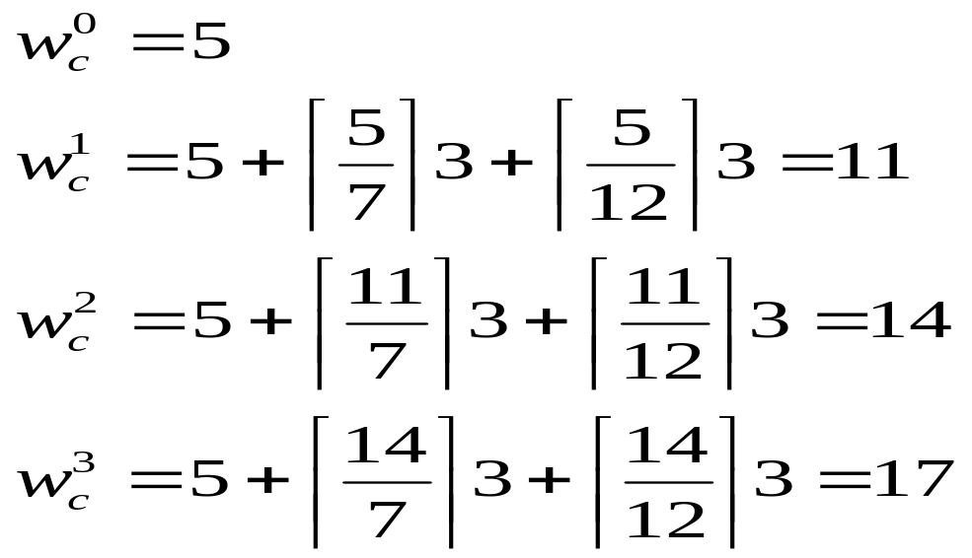
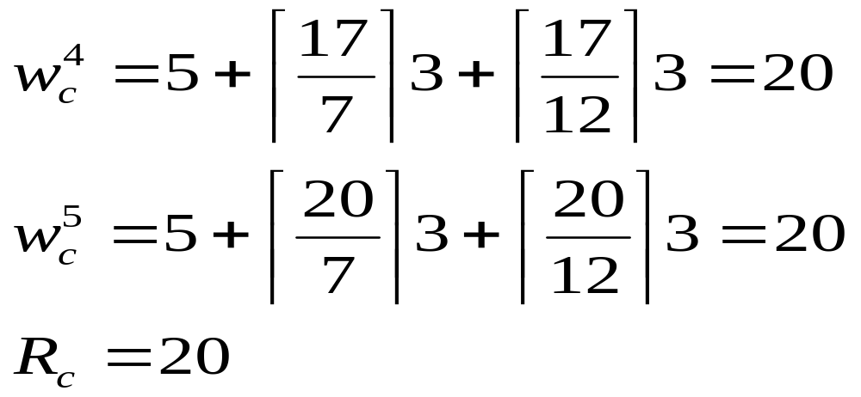

Slide 34
Revisit: Process Set C
Process Period ComputationTime Priority Response time
T C P R
a 80 40 1 80
b 40 10 2 15
c 20 5 3 5
The combined utilization is 1.0
This was above the ulilization threshold for three processes (0.78), therefore it failed the test
The response time analysis shows that the process set will meet all its deadlines
RTA is necessary and sufficient

Slide 35
Response Time Analysis
Is sufficient and necessary
If the process set passes the test they will meet all their deadlines; if they fail the test then, at run-time, a process will miss its deadline (unless the computation time estimations themselves turn out to be pessimistic)

Slide 36
Worst-Case Execution Time - WCET
Obtained by either measurement or analysis
The problem with measurement is that it is difficult to be sure when the worst case has been observed
The drawback of analysis is that an effective model of the processor (including caches, pipelines, memory wait states and so on) must be available

Slide 37
WCET— Finding C
Most analysis techniques involve two distinct activities.
The first takes the process and decomposes its code into a directed graph of basic blocks
These basic blocks represent straight-line code.
The second component of the analysis takes the machine code corresponding to a basic block and uses the processor model to estimate its worst-case execution time
Once the times for all the basic blocks are known, the directed graph can be collapsed

Slide 38
Need for Semantic Information
for I in 1.. 10 loop
if Cond then
-- basic block of cost 100
else
-- basic block of cost 10
end if;
end loop;
Simple cost 10*100 (+overhead), say 1005.
But if Cond only true on 3 occasions then cost is 375

Slide 39

Sporadic Processes
Sporadics processes have a minimum inter-arrival time
They also require D<T
The response time algorithm for fixed priority scheduling works perfectly for values of D less than T as long as the stopping criteria becomes
It also works perfectly well with any priority ordering — hp(i) always gives the set of higher-priority processes

Slide 40
Hard and Soft Processes
In many situations the worst-case figures for sporadic processes are considerably higher than the averages
Interrupts often arrive in bursts and an abnormal sensor reading may lead to significant additional computation
Measuring schedulability with worst-case figures may lead to very low processor utilizations being observed in the actual running system

Slide 41
General Guidelines
Rule 1 — all processes should be schedulable using average execution times and average arrival rates
Rule 2 — all hard real-time processes should be schedulable using worst-case execution times and worst-case arrival rates of all processes (including soft)
A consequent of Rule 1 is that there may be situations in which it is not possible to meet all current deadlines
This condition is known as a transient overload
Rule 2 ensures that no hard real-time process will miss its deadline
If Rule 2 gives rise to unacceptably low utilizations for “normal execution” then action must be taken to reduce the worst-case execution times (or arrival rates)

Slide 42
Aperiodic Processes
These do not have minimum inter-arrival times
Can run aperiodic processes at a priority below the priorities assigned to hard processes, therefore, they cannot steal, in a pre-emptive system, resources from the hard processes
This does not provide adequate support to soft processes which will often miss their deadlines
To improve the situation for soft processes, a server can be employed.
Servers protect the processing resources needed by hard processes but otherwise allow soft processes to run as soon as possible.
POSIX supports Sporadic Servers

Slide 43
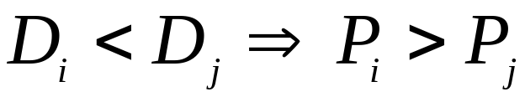
Process Sets with D < T
For D = T, Rate Monotonic priority ordering is optimal
For D < T, Deadline Monotonic priority ordering is optimal

Slide 44
D < T Example Process Set
Process Period Deadline ComputationTime Priority Response time
T D C P R
a 20 5 3 4 3
b 15 7 3 3 6
c 10 10 4 2 10
d 20 20 3 1 20

Slide 45
Proof that DMPO is Optimal
Deadline monotonic priority ordering (DMPO) is optimal if any process set, Q, that is schedulable by priority scheme, W, is also schedulable by DMPO
The proof of optimality of DMPO involves transforming the priorities of Q (as assigned by W) until the ordering is DMPO
Each step of the transformation will preserve schedulability

Slide 46



DMPO Proof Continued
Let i and j be two processes (with adjacent priorities) in Q such that under W
Define scheme W’ to be identical to W except that processes i and j are swapped
Consider the schedulability of Q under W’
All processes with priorities greater than will be unaffected by this change to lower-priority processes
All processes with priorities lower than will be unaffected; they will all experience the same interference from i and j
Process j, which was schedulable under W, now has a higher priority, suffers less interference, and hence must be schedulable under W’

Slide 47


DMPO Proof Continued
All that is left is the need to show that process i, which has had its priority lowered, is still schedulable
Under W
Hence process j only interferes once during the execution of i
It follows that:
It can be concluded that process i is schedulable after the switch
Priority scheme W’ can now be transformed to W" by choosing two more processes that are in the wrong order for DMP and switching them

Slide 48
Process Interactions and Blocking
If a process is suspended waiting for a lower-priority process to complete some required computation then the priority model is, in some sense, being undermined
It is said to suffer priority inversion
If a process is waiting for a lower-priority process, it is said to be blocked

Slide 49
Priority Inversion
To illustrate an extreme example of priority inversion, consider the executions of four periodic processes: a, b, c and d; and two resources: Q and V
Process Priority Execution Sequence Release Time
a 1 EQQQQE 0
b 2 EE 2
c 3 EVVE 2
d 4 EEQVE 4

Slide 50
Example of Priority Inversion
Process
d
c
b
a
0
2
4
6
8
10
12
14
16
18
Executing
Preempted
Executing with Q locked
Blocked
Executing with V locked

Slide 51
Priority Inheritance
If process p is blocking process q, then q runs with p's priority
Process
d
c
b
a
0
2
4
6
8
10
12
14
16
18

Slide 52
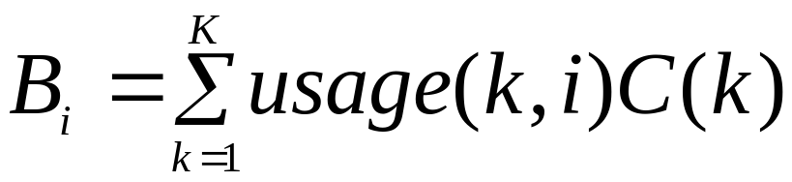
Calculating Blocking
If a process has m critical sections that can lead to it being blocked then the maximum number of times it can be blocked is m
If B is the maximum blocking time and K is the number of critical sections, the process i has an upper bound on its blocking given by:

Slide 53
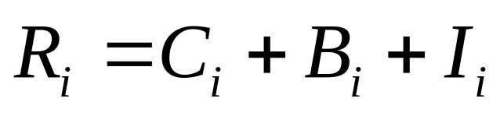
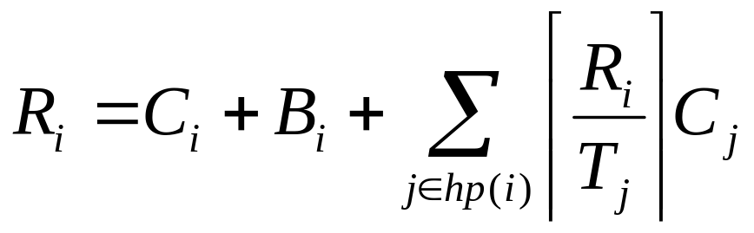
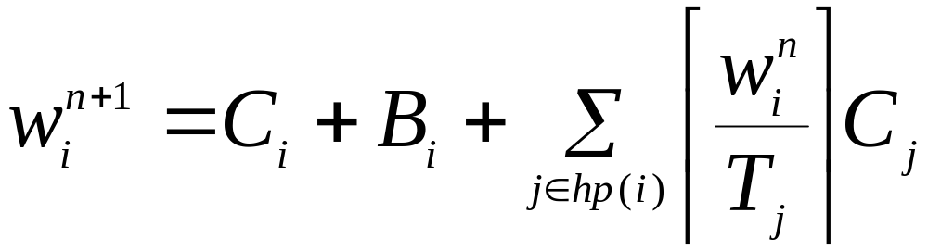
Response Time and Blocking

Slide 54
Priority Ceiling Protocols
Two forms
Original ceiling priority protocol
Immediate ceiling priority protocol

Slide 55
On a Single Processor
A high-priority process can be blocked at most once during its execution by lower-priority processes
Deadlocks are prevented
Transitive blocking is prevented
Mutual exclusive access to resources is ensured (by the protocol itself

Slide 56
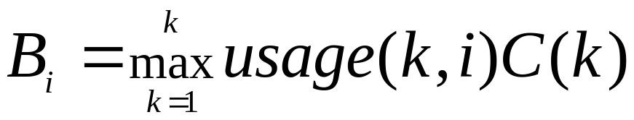
OCPP
Each process has a static default priority assigned (perhaps by the deadline monotonic scheme)
Each resource has a static ceiling value defined, this is the maximum priority of the processes that use it
A process has a dynamic priority that is the maximum of its own static priority and any it inherits due to it blocking higher-priority processes.
A process can only lock a resource if its dynamic priority is higher than the ceiling of any currently locked resource (excluding any that it has already locked itself)

Slide 57
OCPP Inheritance
Process
d
c
b
a
0
2
4
6
8
10
12
14
16
18

Slide 58
ICPP
Each process has a static default priority assigned (perhaps by the deadline monotonic scheme).
Each resource has a static ceiling value defined, this is the maximum priority of the processes that use it.
A process has a dynamic priority that is the maximum of its own static priority and the ceiling values of any resources it has locked
As a consequence, a process will only suffer a block at the very beginning of its execution
Once the process starts actually executing, all the resources it needs must be free; if they were not, then some process would have an equal or higher priority and the process's execution would be postponed

Slide 59
ICPP Inheritance
Process
d
c
b
a
0
2
4
6
8
10
12
14
16
18

Slide 60
OCPP versus ICPP
Although the worst-case behaviour of the two ceiling schemes is identical (from a scheduling view point), there are some points of difference:
  ICCP is easier to implement than the original (OCPP) as blocking relationships need not be monitored
  ICPP leads to less context switches as blocking is prior to first execution
  ICPP requires more priority movements as this happens with all resource usage
  OCPP changes priority only if an actual block has occurred
Note that ICPP is called Priority Protect Protocol in POSIX and Priority Ceiling Emulation in Real-Time Java

Slide 61
An Extendible Process Model
So far:
Deadlines can be less than period (D<T)
Sporadic and aperiodic processes, as well as periodic processes, can be supported
Process interactions are possible, with the resulting blocking being factored into the response time equations

Slide 62
Extensions
Cooperative Scheduling
Release Jitter
Arbitrary Deadlines
Fault Tolerance
Offsets
Optimal Priority Assignment

Slide 63
Cooperative Scheduling
True preemptive behaviour is not always acceptable for safety-critical systems
Cooperative or deferred preemption splits processes into slots
Mutual exclusion is via non-preemption
The use of deferred preemption has two important advantages
  It increases the schedulability of the system, and it can lead to lower values of C
  With deferred preemption, no interference can occur during the last slot of execution.

Slide 64

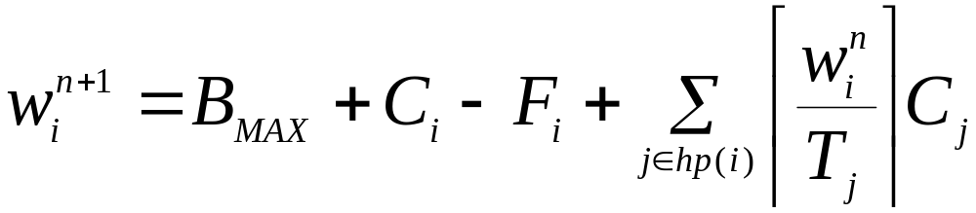

Cooperative Scheduling
Let the execution time of the final block be
When this converges that is, , the response time is given by:

Slide 65
Release Jitter
A key issue for distributed systems
Consider the release of a sporadic process on a different processor by a periodic process, l, with a period of 20
First execution l finishes at R
l
Second execution of l finishes after C
t
t+15
t+20
Time
Release sporadic process at time 0, 5, 25, 45

Slide 66



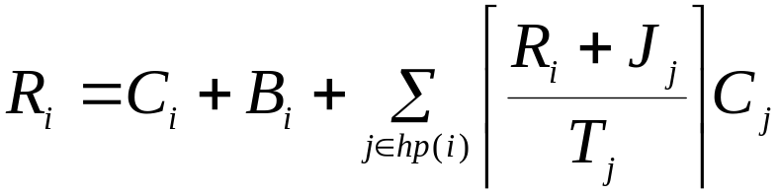

Release Jitter
Sporadic is released at 0, T-J, 2T-J, 3T-J
Examination of the derivation of the schedulability equation implies that process i will suffer
  one interference from process s if
  two interfernces if
  three interference if
This can be represented in the response time equations
If response time is to be measured relative to the real release time then the jitter value must be added

Slide 67
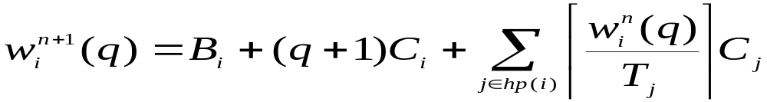


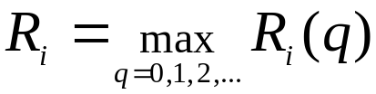
Arbitrary Deadlines
To cater for situations where D (and hence potentially R) > T
The number of releases is bounded by the lowest value of q for which the following relation is true:
The worst-case response time is then the maximum value found for each q:

Slide 68
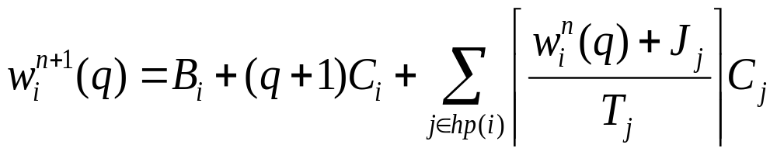
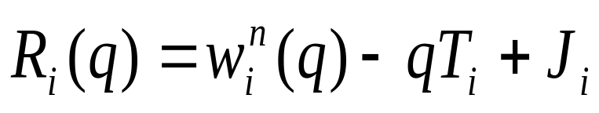
Arbitrary Deadlines
When formulation is combined with the effect of release jitter, two alterations to the above analysis must be made
First, the interference factor must be increased if any higher priority processes suffers release jitter:
The other change involves the process itself. If it can suffer release jitter then two consecutive windows could overlap if response time plus jitter is greater than period.

Slide 69

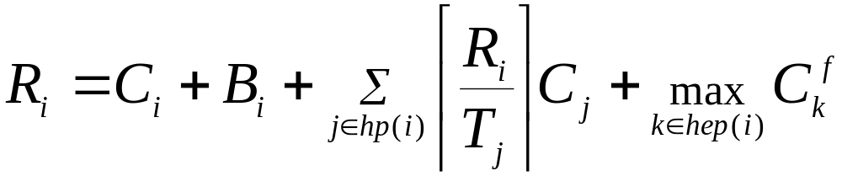
Fault Tolerance
Fault tolerance via either forward or backward error recovery always results in extra computation
This could be an exception handler or a recovery block.
In a real-time fault tolerant system, deadlines should still be met even when a certain level of faults occur
This level of fault tolerance is know as the fault model
If the extra computation time that results from an error in process i is
where hep(i) is set of processes with priority equal to or higher than i

Slide 70
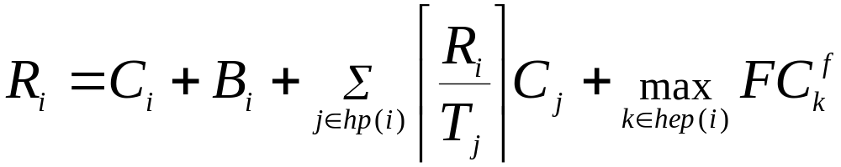

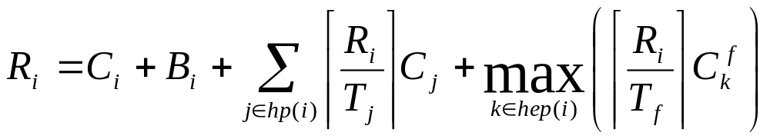
Fault Tolerance
If F is the number of faults allows
If there is a minimum arrival interval

Slide 71
Offsets
So far assumed all processes share a common release time (critical instant)
Process T D C R
a 8 5 4 4
b 20 10 4 8
c 20 12 4 16
With offsets
Process T D C O R
a 8 5 4 0 4
b 20 10 4 0 8
c 20 12 4 10 8
Arbitrary offsets are not amenable to analysis

Slide 72
Non-Optimal Analysis
In most realistic systems, process periods are not arbitrary but are likely to be related to one another
As in the example just illustrated, two processes have a common period. In these situations it is ease to give one an offset (of T/2) and to analyse the resulting system using a transformation technique that removes the offset — and, hence, critical instant analysis applies.
In the example, processes b and c (having the offset of 10) are replaced by a single notional process with period 10, computation time 4, deadline 10 but no offset

Slide 73
Non-Optimal Analysis
This notional process has two important properties.
  If it is schedulable (when sharing a critical instant with all other processes) then the two real process will meet their deadlines when one is given the half period offset
  If all lower priority processes are schedulable when suffering interference from the notional process (and all other high-priority processes) then they will remain schedulable when the notional process is replaced by the two real process (one with the offset).
These properties follow from the observation that the notional process always uses more (or equal) CPU time than the two real process
Process T D C O R
a 8 5 4 0 4
n 10 10 4 0 8

Slide 74
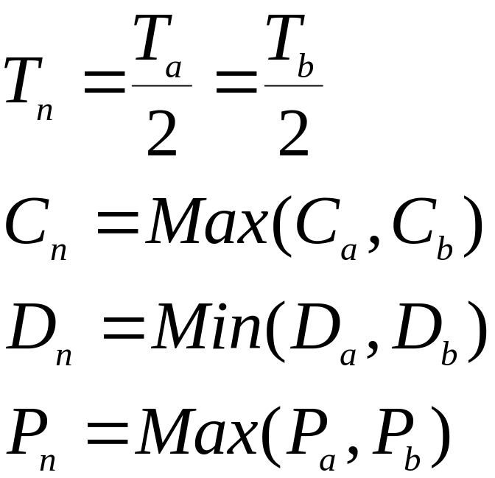
Notional Process Parameters
Can be extended to more than two processes

Slide 75
Priority Assignment
Theorem
If process p is assigned the lowest priority and is feasible then, if a feasible priority ordering exists for the complete process set, an ordering exists with process p assigned the lowest priority
procedure Assign_Pri (Set : in out Process_Set; N : Natural;
Ok : out Boolean) is
begin
for K in 1..N loop
for Next in K..N loop
Swap(Set, K, Next);
Process_Test(Set, K, Ok);
exit when Ok;
end loop;
exit when not Ok; -- failed to find a schedulable process
end loop;
end Assign_Pri;

Slide 76
Dynamic Systems and Online Analysis
There are dynamic soft real-time applications in which arrival patterns and computation times are not known a priori
Although some level of off-line analysis may still be applicable, this can no longer be complete and hence some form of on-line analysis is required
The main task of an on-line scheduling scheme is to manage any overload that is likely to occur due to the dynamics of the system's environment
EDF is a dynamic scheduling scheme that is an optimal
During transient overloads EDF performs very badly. It is possible to get a cascade effect in which each process misses its deadline but uses sufficient resources to result in the next process also missing its deadline.

Slide 77
Admission Schemes
To counter this detrimental domino effect many on-line schemes have two mechanisms:
  an admissions control module that limits the number of processes that are allowed to compete for the processors, and
  an EDF dispatching routine for those processes that are admitted
An ideal admissions algorithm prevents the processors getting overloaded so that the EDF routine works effectively

Slide 78
Values
If some processes are to be admitted, whilst others rejected, the relative importance of each process must be known
This is usually achieved by assigning value
Values can be classified
  Static: the process always has the same value whenever it is released.
  Dynamic: the process's value can only be computed at the time the process is released (because it is dependent on either environmental factors or the current state of the system)
  Adaptive: here the dynamic nature of the system is such that the value of the process will change during its execution
To assign static values requires the domain specialists to articulate their understanding of the desirable behaviour of the system

Slide 79
Programming Priority-Based Systems
Ada
POSIX
Real-Time Java

Slide 80
Ada: Real-Time Annex
Ada 95 has a flexible model:
  base and active priorities
  priority ceiling locking
  various dispatching policies using active priority
  dynamic priorities
subtype Any_Priority is Integer
range Implementation-Defined;
subtype Priority is Any_Priority range
Any_Priority'First .. Implementation-Defined;
subtype Interrupt_Priority is Any_Priority range
Priority'Last + 1 .. Any_Priority'Last;
Default_Priority : constant Priority :=
(Priority'First + Priority'Last)/2;
An implementation must support a range of Priority of at least 30 and at least one distinct Interrupt_Priority

Slide 81
Assigning Base Priorities
Using a pragma
task Controller is
pragma Priority(10);
end Controller;
task type Servers(Pri : System.Priority) is
-- each instance of the task can have a
-- different priority
entry Service1(...);
entry Service2(...);
pragma Priority(Pri);
end Servers;

Slide 82
Priority Ceiling Locking
Protected objects need to maintain the consistency of their data
Mutual exclusion can be guaranteed by use of the priority model
Each protected object is assigned a ceiling priority which is greater than or equal to the highest priority of any of its calling tasks
When a task calls a protected operation, its priority is immediately raised to that of the protected object
If a task wishing to enter a protected operation is running then the protected object cannot be already occupied

Slide 83
Ceiling Locking
Each protected object is assigned a priority using a pragma
If the pragma is missing, Priority'Last is assumed
Program_Error is raised if the calling task's active priority is greater than the ceiling
If an interrupt handler is attached to a protected operation and the wrong ceiling priority has been set, then the program becomes erroneous
With ceiling locking, an effective implementation will use the thread of the calling task to execute not only the protected operation but also to execute the code of any other tasks that are released as a result of the call

Slide 84
Example of Ceiling Priority
protected Gate_Control is
pragma Priority(28);
entry Stop_And_Close;
procedure Open;
private
Gate : Boolean := False;
end Gate_Control;
protected body Gate_Control is
entry Stop_And_Close
when Gate is
begin
Gate := False;
end;
procedure Open is
begin
Gate := True;
end;
end Gate_Control;

Slide 85
Example
Assume task T, priority 20, calls Stop_And_Close and is blocked. Later task S, priority 27, calls Open. The thread executing S will undertake the following operations:
  the code of Open for S
  evaluate the barrier on the entry and note that T can now proceed
  the code Stop_And_Close for T
  evaluate the barrier again
  continue with the execution of S after its call on the protected object
There is no context switch

Slide 86
Active Priorities
A task entering a protected operation has its priority raised
A task’s active priority might also change during:
  task activation ⎯ a task inherits the active priority of the parent task which created it (to avoid priority inversion)
  during a rendezvous ⎯ the task executing a rendezvous will inherit the active priority of the caller if it is greater than its current active priority
  Note: no inheritance when waiting for task termination

Slide 87
Dispatching
The order of dispatching is determined by the tasks' active priorities
Default is preemptive priority based
Not defined exactly what this means on a multi-processor system
One policy defined by annex: FIFO_Within_Priority
When a task becomes runnable it is placed at the back on the run queue for its priority; when it is preempted, it is placed at the front

Slide 88
Entry Queue Policies
A programmer may choose the queuing policy for a task's entry queue and the select statement
Two predefined policies: FIFO_Queuing (default) and Priority_Queuing
With Priority_Queuing and the select statement, an alternative that is open and has the highest priority task queued (of all open alternatives) is chosen
If there are two open with equal priority tasks, the one which appears textually first in the program is chosen
Tasks are queued in active priority order, if active priority changes then no requeuing takes place; if the base priority changes, the task is removed and requeued

Slide 89
Dynamic Priorities
Some applications require the base priority of a task to change dynamically: e.g., mode changes, or to implement dynamic scheduling schemes such as earliest deadline scheduling

Slide 90
Package Specification
with Ada.Task_Identification; use Ada;
package Ada.Dynamic_Priorities is
procedure Set_Priority(Priority : System.Any_Priority;
T : Task_Identification.Task_Id :=
Task_Identification.Current_Task);
function Get_Priority(T : T_Identification.Task_Id
:= Task_Identification.Current_Task)
return System.Any_Priority;
-- raise Tasking_Error if task has terminated
-- Both raise Program_Error if a Null_Task_Id is passed
private
-- not specified by the language
end Ada.Dynamic_Priorities;

Slide 91
Dynamic Priorities
The effect of a change of base priorities should be as soon as practical but not during an abort deferred operation and no later than the next abort completion point
Changing a task's base priority can affect its active priority and have an impact on dispatching and queuing

Slide 92
POSIX
POSIX supports priority-based scheduling, and has options to support priority inheritance and ceiling protocols
Priorities may be set dynamically
Within the priority-based facilities, there are four policies:
  FIFO: a process/thread runs until it completes or it is blocked
  Round-Robin: a process/thread runs until it completes or it is blocked or its time quantum has expired
  Sporadic Server: a process/thread runs as a sporadic server
  OTHER: an implementation-defined
For each policy, there is a minimum range of priorities that must be supported; 32 for FIFO and round-robin
The scheduling policy can be set on a per process and a per thread basis

Slide 93
POSIX
Threads may be created with a system contention option, in which case they compete with other system threads according to their policy and priority
Alternatively, threads can be created with a process contention option where they must compete with other threads (created with a process contention) in the parent process
  It is unspecified how such threads are scheduled relative to threads in other processes or to threads with global contention
A specific implementation must decide which to support

Slide 94
Sporadic Server
A sporadic server assigns a limited amount of CPU capacity to handle events, has a replenishment period, a budget, and two priorities
The server runs at a high priority when it has some budget left and a low one when its budget is exhausted
When a server runs at the high priority, the amount of execution time it consumes is subtracted from its budget
The amount of budget consumed is replenished at the time the server was activated plus the replenishment period
When its budget reaches zero, the server's priority is set to the low value

Slide 95
Other Facilities
POSIX allows:
priority inheritance to be associated with mutexes (priority protected protocol= ICPP)
message queues to be priority ordered
functions for dynamically getting and setting a thread's priority
threads to indicate whether their attributes should be inherited by any child thread they create

Slide 96
RT Java Threads and Scheduling
There are two entities in Real-Time Java which can be scheduled:
  RealtimeThreads (and NoHeapRealtimeThread)
  AsynEventHandler (and BoundAyncEventHandler)
Objects which are to be scheduled must
  implement the Schedulable interface
  specify their
    SchedulingParameters
    ReleaseParameters
    MemoryParameters

Slide 97
Real-Time Java
Real-Time Java implementations are required to support at least 28 real-time priority levels
As with Ada and POSIX, the larger the integer value, the higher the priority
Non real-time threads are given priority levels below the minimum real-time priority
Note, scheduling parameters are bound to threads at thread creation time; if the parameter objects are changed, they have an immediate impact on the associated thread
Like Ada and Real-Time POSIX, Real-Time Java supports a pre-emptive priority-based dispatching policy
Unlike Ada and RT POSIX, RT Java does not require a preempted thread to be placed at the head of the run queue associated with its priority level

Slide 98
The Schedulable Interface
public interface Schedulable extends java.lang.Runnable
{
public void addToFeasibility();
public void removeFromFeasibility();
public MemoryParameters getMemoryParameters();
public void setMemoryParameters(MemoryParameters memory);
public ReleaseParameters getReleaseParameters();
public void setReleaseParameters(ReleaseParameters release);
public SchedulingParameters getSchedulingParameters();
public void setSchedulingParameters(
SchedulingParameters scheduling);
public Scheduler getScheduler();
public void setScheduler(Scheduler scheduler);
}

Slide 99
Scheduling Parameters
public abstract class SchedulingParameters
{ public SchedulingParameters(); }
public class PriorityParameters extends SchedulingParameters
{
public PriorityParameters(int priority);
public int getPriority(); // at least 28 priority levels
public void setPriority(int priority) throws
IllegalArgumentException;
...
}
public class ImportanceParameters extends PriorityParameters
{
public ImportanceParameters(int priority, int importance);
public int getImportance();
public void setImportance(int importance);
...
}

Slide 100
RT Java: Scheduler
Real-Time Java supports a high-level scheduler whose goals are:
  to decide whether to admit new schedulable objects according to the resources available and a feasibility algorithm, and
  to set the priority of the schedulable objects according to the priority assignment algorithm associated with the feasibility algorithm
Hence, whilst Ada and Real-Time POSIX focus on static off-line schedulability analysis, Real-Time Java addresses more dynamic systems with the potential for on-line analysis

Slide 101
The Scheduler
public abstract class Scheduler
{
public Scheduler();
protected abstract void addToFeasibility(Schedulable s);
protected abstract void removeFromFeasibility(Schedulable s);
public abstract boolean isFeasible();
// checks the current set of schedulable objects
public boolean changeIfFeasible(Schedulable schedulable,
ReleaseParameters release, MemoryParameters memory);
public static Scheduler getDefaultScheduler();
public static void setDefaultScheduler(Scheduler scheduler);
public abstract java.lang.String getPolicyName();
}

Slide 102
The Scheduler
The Scheduler is an abstract class
The isFeasible method considers only the set of schedulable objects that have been added to its feasibility list (via the addToFeasibility and removeFromFeasibility methods)
The method changeIfFeasible checks to see if its set of objects is still feasible if the given object has its release and memory parameters changed
If it is, the parameters are changed
Static methods allow the default scheduler to be queried or set
RT Java does not require an implementation to provide an on-line feasibility algorithm

Slide 103
The Priority Scheduler
class PriorityScheduler extends Scheduler
{
public PriorityScheduler()
protected void addToFeasibility(Schedulable s);
...
public void fireSchedulable(Schedulable schedulable);
public int getMaxPriority();
public int getMinPriority();
public int getNormPriority();
public static PriorityScheduler instance();
...
}
Standard preemptive priority-based scheduling

Slide 104
Other Facilities
Priority inheritance and ICCP (called priority ceiling emulation)
Support for aperiodic threads in the form of processing groups; a group of aperiodic threads can be linked together and assigned characteristics which aid the feasibility analysis

Slide 105
Summary
A scheduling scheme defines an algorithm for resource sharing and a means of predicting the worst-case behaviour of an application when that form of resource sharing is used.
With a cyclic executive, the application code must be packed into a fixed number of minor cycles such that the cyclic execution of the sequence of minor cycles (the major cycle) will enable all system deadlines to be met
The cyclic executive approach has major drawbacks many of which are solved by priority-based systems
Simple utilization-based schedulability tests are not exact

Slide 106
Summary
Response time analysis is flexible and caters for:
  Periodic and sporadic processes
  Blocking caused by IPC
  Cooperative scheduling
  Arbitrary deadlines
  Release jitter
  Fault tolerance
  Offsets
Ada, RT POSIX and RT Java support preemptive priority-based scheduling
Ada and RT POSIX focus on static off-line schedulability analysis, RT Java addresses more dynamic systems with the potential for on-line analysis

